Slide 1

CSE 4128 : Image Processing and Computer Vision Laboratory
Osteosarcoma Cell Nucleus Segmentation
Supervised by:
Dr. Sk. Md. Masudul Ahsan
Professor Department of Computer Science and Engineering Khulna University of Engineering & Technology Md Tajmilur Rahman
Lecturer Department of Computer Science and Engineering Khulna University of Engineering & Technology
Presented By:
Ahsanul Haque Hasib
Roll: 2007020
Department of Computer Science and Engineering
Khulna University of Engineering & Technology

Slide 2
Outline
Objectives
Introduction
Tools Used
Methodology
User Interface
Limitations
Conclusion
References

Slide 3
Objectives
To develop an automated system to detect and segment Osteosarcoma cell nuclei.
To utilize image processing algorithms for the implementation of the whole system.
To try and ensure high accuracy in identifying the nucleuses.
To get an approximate count of the nucleuses along with individual descriptors for each segmented object.
To create a user-friendly interface for uploading, processing and displaying the segmented image along with intermediate results with step‑by‑step visualization and parameter control (σ, method variants).

Slide 4
Introduction
Osteosarcoma is a highly malignant primary bone tumor that predominantly affects children and young adults.
Localized histogram equalization with clipping control, improved nuclear visibility without amplifying noise.
Smoothing reduces random noises and fluctuations.
Thresholding separates nuclei from background automatically by maximizing between-class variance in gray-level distribution.
Morphological operations and connected component labeling finally derives the segmented result.
These classical methods are transparent, computationally efficient, and well-suited for histopathological image analysis and cytology.

Slide 5
Tools Used
Python
OpenCV (Open Source Computer Vision Library)
Numpy
Gradio (For designing User Interface)

Slide 6
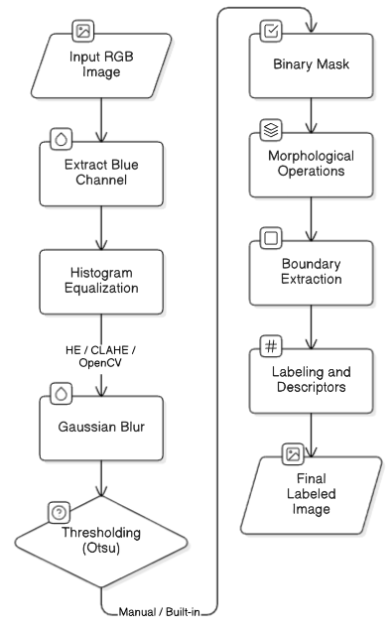
Methodology
Blue Channel extraction from DAPI-stained image.
Perform Histogram Equalization(Global and CLAHE).
Denoise using Gaussian filter.
Threshold the smoothed image using Otsu’s Thresholding.
Morphological operations like opening and closing for removing salt noise and filling holes.
Labelling each segments using connected components.
Extract boundary for each segments and get descriptors.
Display the final segmented output with boundaries overlayed and total counts.
Figure-1: Flow Diagram for the whole system
Source: Adapted from Win, K. Y. et al.(2018). Comparative Study on Automated Cell Nuclei Segmentation Methods for Cytology Pleural Effusion Images.

Slide 7
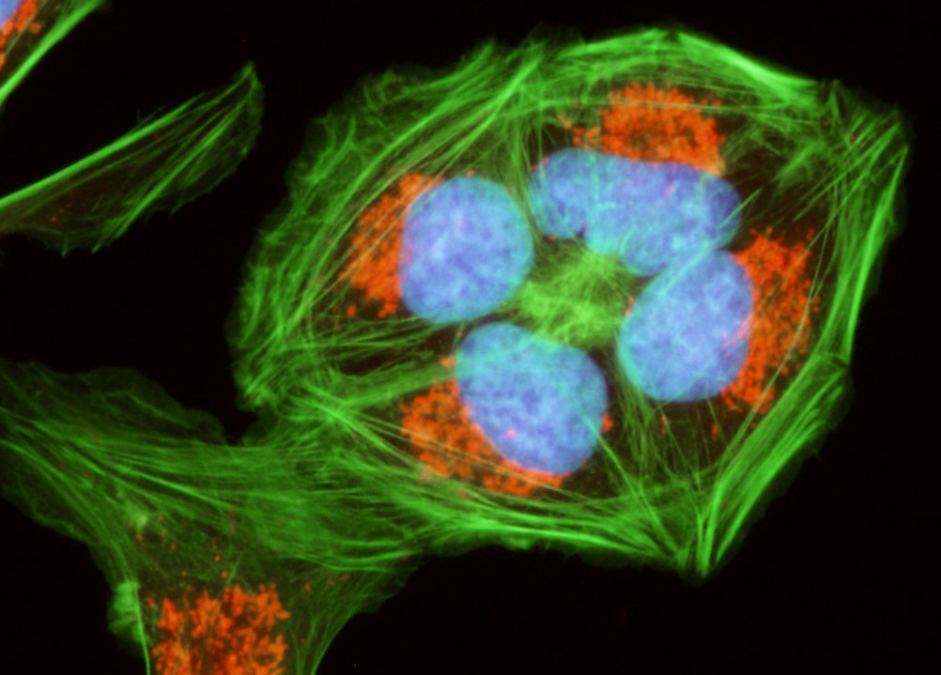
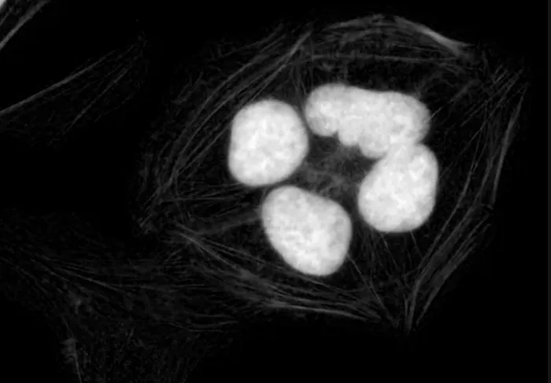
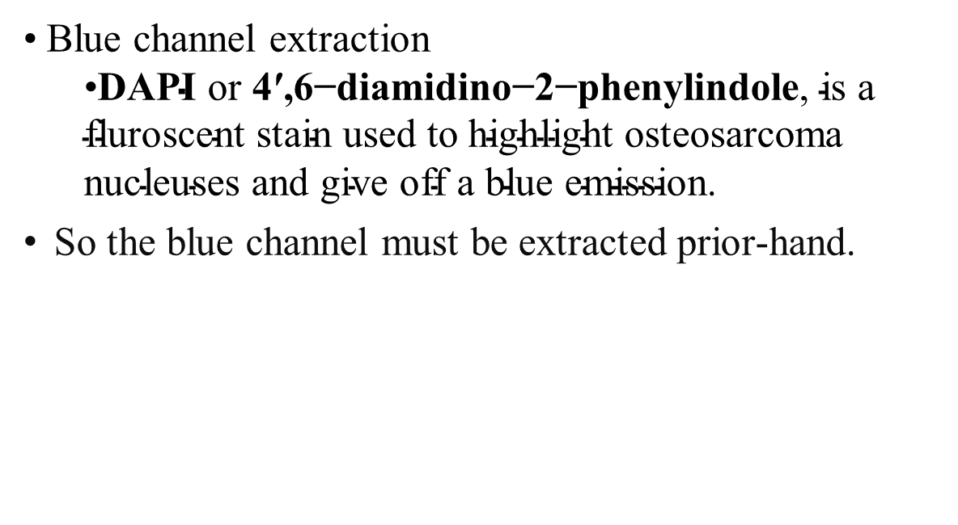
Methodology(Contd.)
Pre-processing
Blue channel extraction
$\text{DAPI} \text{or} \text{4}\text{′}\text{,}\text{6}\text{−}\text{diamidino}\text{−}\text{2}\text{−}\text{phenylindole}\text{, }\text{is} \text{a} \text{fluroscent} \text{stain} \text{used} \text{to} \text{highlight} \text{osteosarcoma} \text{nucleuses} \text{and} \text{give} \text{off} \text{a} \text{blue} \text{emission}\text{.}$
So the blue channel must be extracted prior-hand.
(a)
(b)
Figure-2: (a)Osteosarcoma Nuclei highlighted with DAPI stain (b) Blue channel extracted
Source: microscopyu.com/

Slide 8
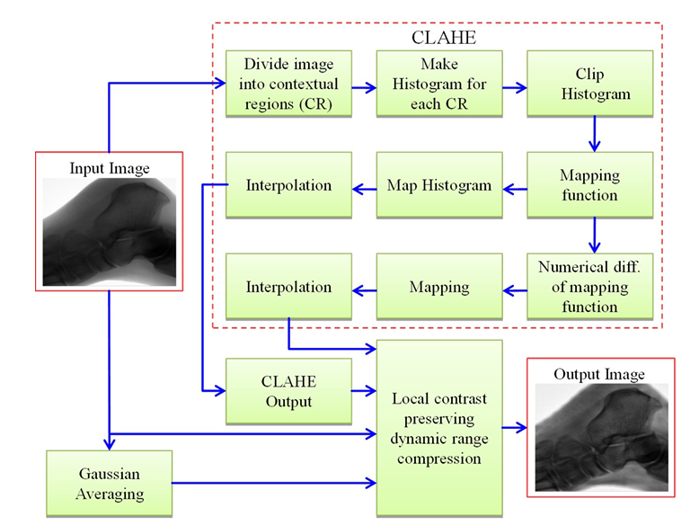
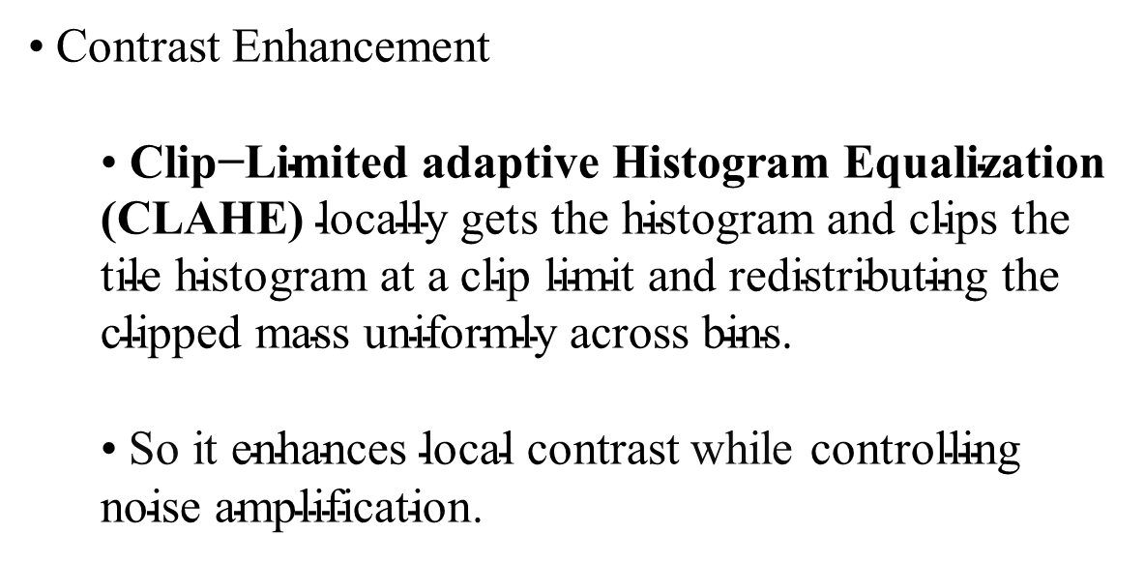
Methodology(Contd.)
Pre-processing
Contrast Enhancement
$\text{Clip}\text{−}\text{Limited} \text{adaptive} \text{Histogram} \text{Equalization} \text{(}\text{CLAHE}\text{) }\text{locally} \text{gets} \text{the} \text{histogram} \text{and} \text{clips} \text{the} \text{tile} \text{histogram} \text{at} \text{a} \text{clip} \text{limit} \text{and} \text{redistributing} \text{the} \text{clipped} \text{mass} \text{uniformly} \text{across} \text{bins}\text{.}$
So it $\text{enhances} \text{local} \text{contrast}$ while $\text{controlling} \text{noise} \text{amplification}$.
Figure-3: Flow Diagram of CLAHE
Source: J. Lee et al. (2015). An Adaptive Histogram Equalization Based Local Technique for Contrast Preserving Image Enhancement.

Slide 9
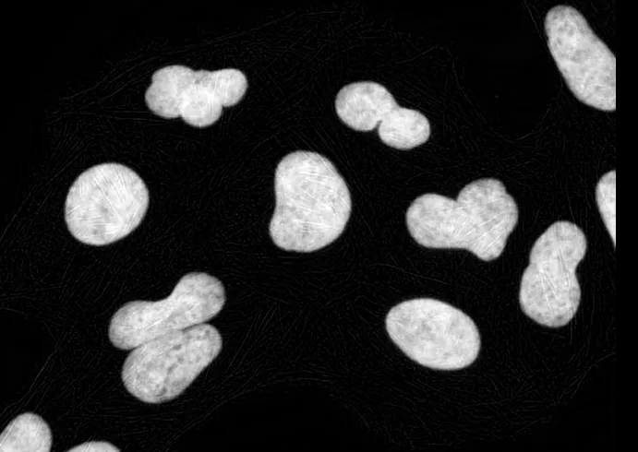

Methodology(Contd.)
Pre-processing(Contrast Enhancement)
Let L = 256 gray levels. Given a tile T of size (tₕ × t_{w}):
Compute histogram h[0 … L−1] and total pixel count |T|.
Compute per-bin clip threshold: hₘₐₓ = clip_limit × (|T| / L)
Clip the histogram: h̃[i] = min(h[i], hₘₐₓ) Accumulate the excess: E = Σ (h[i] − hₘₐₓ),
Redistribute excess uniformly: ĥ[i] = h̃[i] + (E / L)
Normalize to a PDF: p[i] = ĥ[i] / Σĥ[j] Compute cumulative distribution: c[i] = Σₖ₌₀ⁱ p[k]
Build lookup table: sk[i] = ⌊c[i] × (L−1)⌋
Remap tile T using the lookup table.
(a)
(b)
Figure-4: (a) Blue channel image
(b) Histogram Equalized image

Slide 10

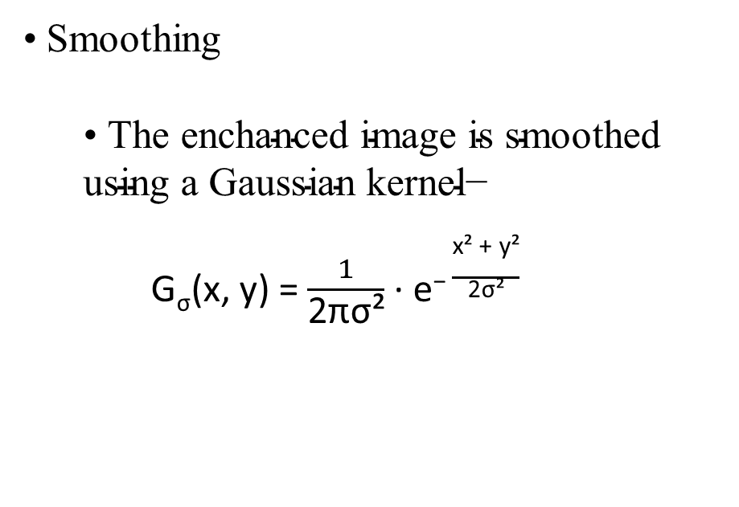
Methodology(Contd.)
Pre-processing
Smoothing
$\text{T}\text{he} \text{enchanced} \text{image} \text{is} \text{smoothed} \text{using} \text{a} \text{Gaussian} \text{kernel}\text{−}$
G_{σ}(x, y) = $\frac{1}{\text{2}\text{πσ}\text{²}}$· e⁻ $\frac{\text{x}\text{² + }\text{y}\text{²}}{\text{2}\text{σ}\text{²}}$
(a)
(b)
Figure-5: (a) Histogram Equalized image
(b) Smoothed image

Slide 11

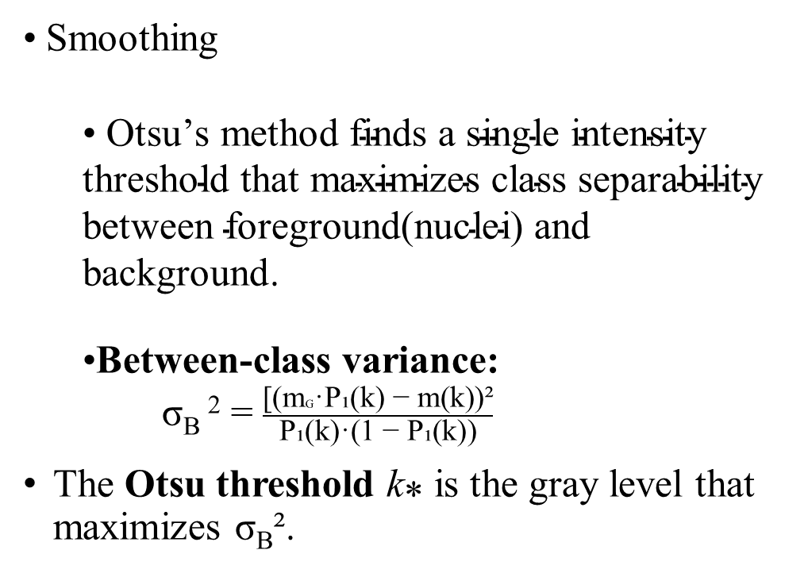
Methodology(Contd.)
Segmentation (Otsu’s Thresholding)
Smoothing
$\text{Otsu}\text{’}\text{s} \text{method} \text{finds} \text{a} \text{single} \text{intensity} \text{threshold} \text{that} \text{maximizes} \text{class} \text{separability} \text{between} \text{foreground}\text{(}\text{nuclei}\text{) }\text{and} \text{background}$.
Between-class variance: σ_{B} ² = $\frac{\text{[(}\text{m}\text{ᴳ}\text{·}\text{P}\text{₁}\text{(}\text{k}\text{) }\text{− }\text{m}\text{(}\text{k}\text{))}\text{²}}{\text{P}\text{₁}\text{(}\text{k}\text{)·(}\text{1 }\text{− }\text{P}\text{₁}\text{(}\text{k}\text{))}}$
The Otsu threshold k⁎ is the gray level that maximizes σ_{B}².
(a)
(b)
Figure-6: (a) Smoothed image
(b) Otsu’s Thresholded image

Slide 12
Methodology(Contd.)
Segmentation(Otsu’s Thresholding)
Algorithm:
Compute normalized histogram pᵢ for i = 0, …, L−1.
Compute cumulative sums P₁(k) for k = 0, …, L−1.
Compute means m(k) for k = 0, …, L−1.
Compute the global mean m_{G}.
For each k, compute σ_{B}²(k) and track the maximum value.
Set k* = k that gives the maximum between-class variance.

Slide 13


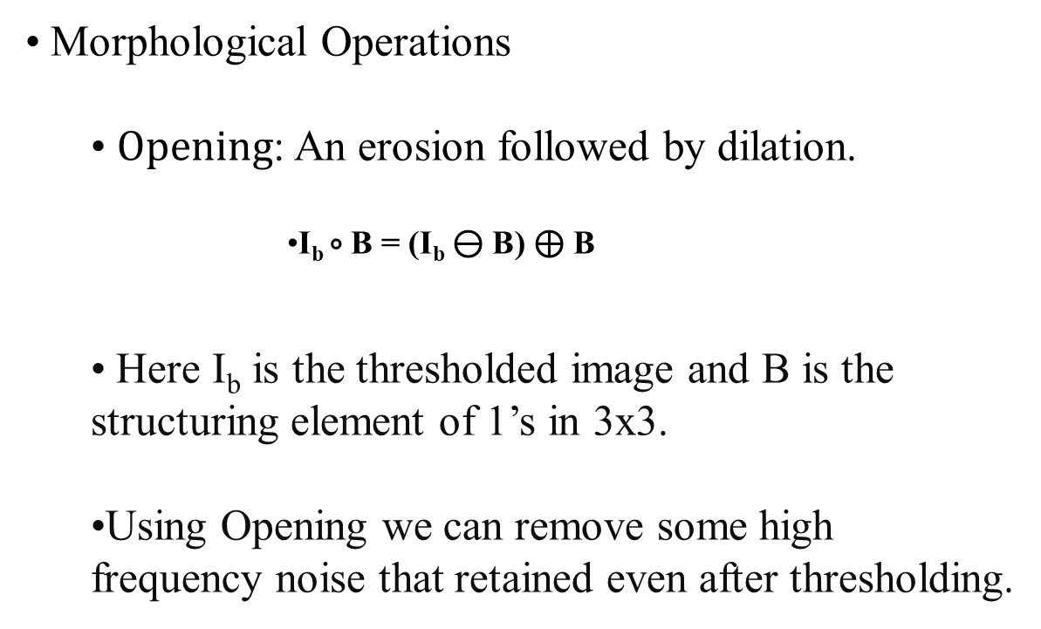
Methodology(Contd.)
Post-processing
Morphological Operations
$Opening$: An erosion followed by dilation.
I_{b} ∘ B = (I_{b} ⊖ B) ⊕ B
Here I_{b} is the thresholded image and B is the structuring element of 1’s in 3x3.
Using Opening we can remove some high frequency noise that retained even after thresholding.
(a)
(b)
Figure-7: (a) Before Opening (b) after Opening with small background noise removed.

Slide 14
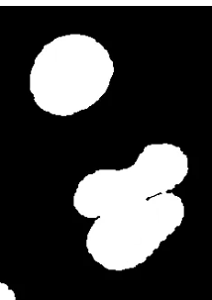
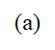
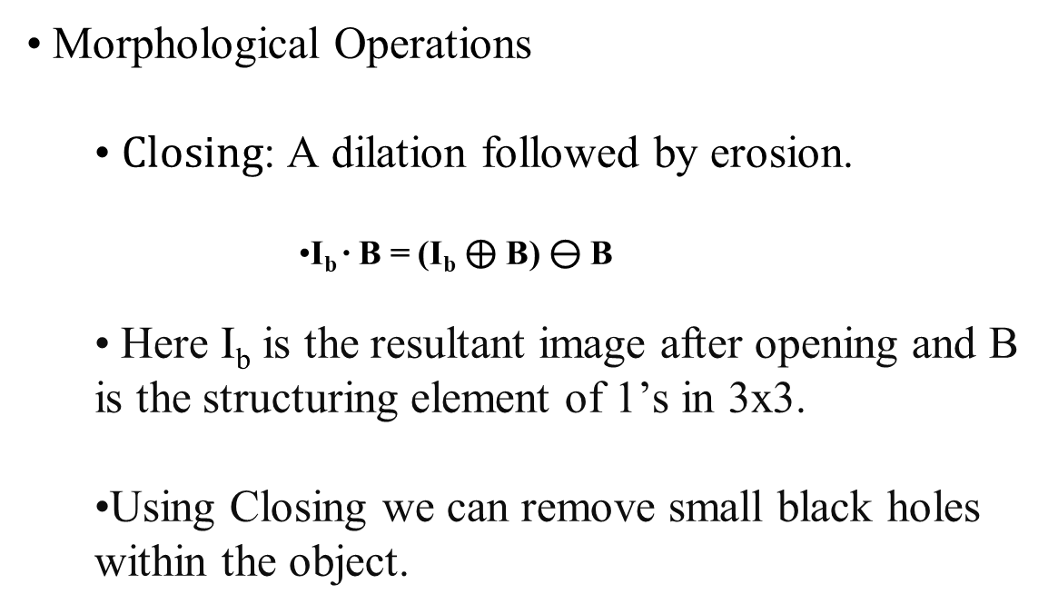
Methodology(Contd.)
Post-processing
Morphological Operations
$Closing$: A dilation followed by erosion.
I_{b} ∙ B = (I_{b} ⊕ B) ⊖ B
Here I_{b} is the resultant image after opening and B is the structuring element of 1’s in 3x3.
Using Closing we can remove small black holes within the object.
(b)
Figure-8: (a) Before Closing (b) after Closing with small foreground hole filled.

Slide 15
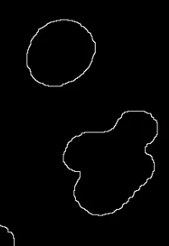
Methodology(Contd.)
Post-processing
Boundary extraction
For this we perform erosion then subtract the eroded image from thresholded image to get boundary.
Boundary = I_{b} - (I_{b} ⊖ B)
Here I_{b} is the resultant image after closing and B is the structuring element of 1’s in 3x3.
(b)
Figure-9: (a) After Closing (b) Boundary extracted

Slide 16
Methodology(Contd.)
Post-processing
Cell counting and labeling
For this we used DFS traversal in the segmented image and labeled the pixels of same connected neighborhood with the same label.
Algorithm
Initialize label matrix L(x, y) with zeros.
For each pixel (x, y): • If M₂(x, y) = 1 (foreground) and L(x, y) = 0, assign a new label k. • Push (x, y) to a stack for region growing.
While the stack is not empty: • Pop a pixel (x′, y′). • For each of its 8-connected neighbors (xₙ, yₙ): – If M₂(xₙ, yₙ) = 1 and L(xₙ, yₙ) = 0, assign label k and push it to the stack.
Increment k and repeat until all pixels are visited.
The total nucleus count is N = k − 1.

Slide 17
Methodology(Contd.)
Post-processing
Region Descriptors
For each cell we compute the following:
Compute region geometry: • Area: Aₖ = number of foreground pixels in each object • Perimeter: Pₖ = number of boundary pixels of object. • Maximum diameter: Dₖ = maximum distance between any two pixels in object.
Compute shape descriptors: • Compactness: Cₖ = (Pₖ²) / Aₖ • Form factor: Fₖ = (4πAₖ) / (Pₖ²) • Roundness: Rₖ = (4Aₖ) / (πDₖ²)

Slide 18
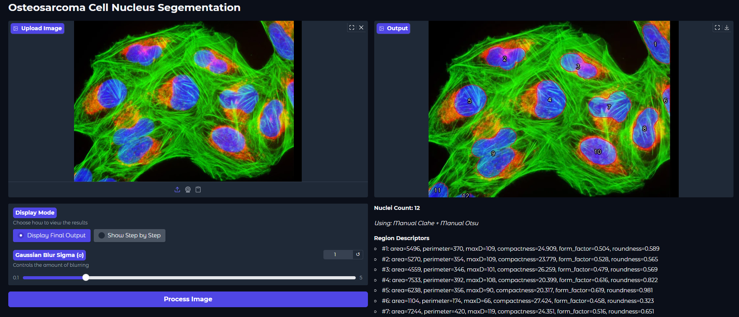
User Interface
Figure-10: User Interface

Slide 19
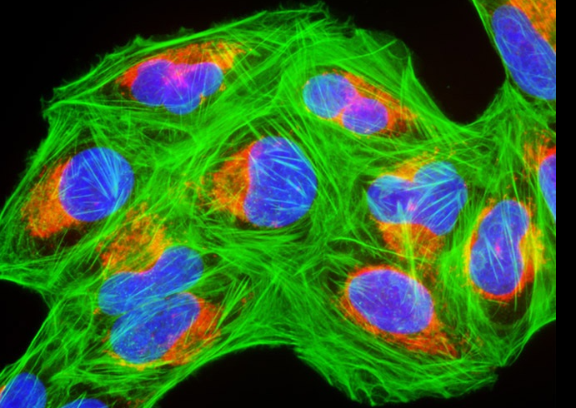
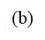
User Interface(Contd.)
Figure-11: (a) Original Image (b) Blue Channel Extracted

Slide 20
User Interface(Contd.)
Figure-12: (a) Blue Channel Extracted (b) Histogram Equalized Image(CLAHE)

Slide 21
User Interface(Contd.)
Figure-13: (a) Histogram Equalized Image(CLAHE) (b) Gaussian blurred Image

Slide 22
User Interface(Contd.)
Figure-14: (a) Gaussian blurred Image (b) Otsu Thresholded Image

Slide 23

User Interface(Contd.)
Figure-15: (a) Otsu Thresholded Image (b) Opening

Slide 24

User Interface(Contd.)
Figure-16: (a) Opening (b) Closing

Slide 25
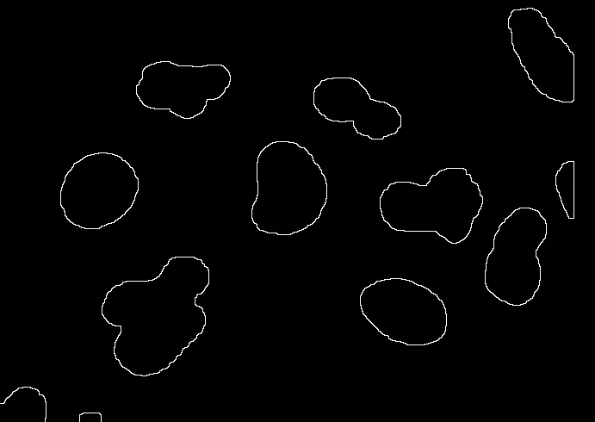
User Interface(Contd.)
Figure-17: (a) Closing (b) Boundaries extracted

Slide 26
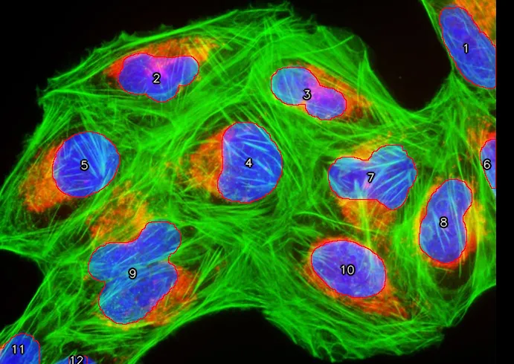
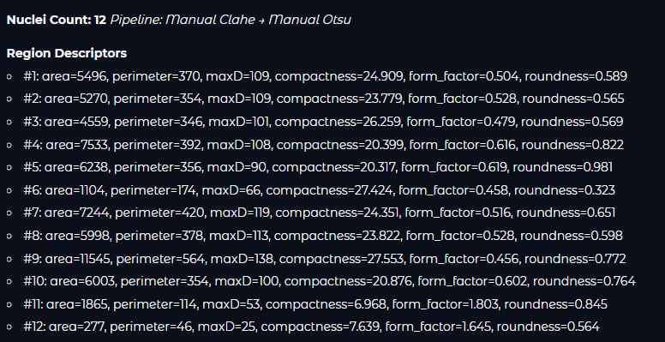
User Interface(Contd.)
Video-1: Demonstration

Slide 27
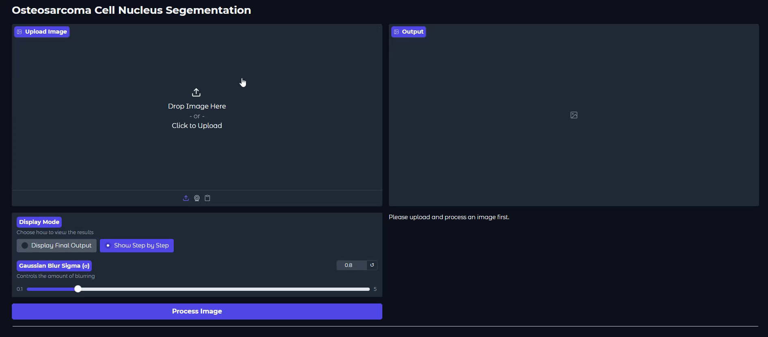
User Interface(Contd.)

Slide 28
Limitations
Otsu assumes bimodality; very uneven illumination or non-bimodality reduces it's efficiency.
CLAHE parameters are image-dependent; excessive clipping can wash out contrast, too little reverts toward AHE and can amplify noise.
Current morphological and threshold-based pipelines cannot fully separate overlapping or touching nuclei, which remain a major limitation.

Slide 29
Conclusion
This work presents an end-to-end, interpretable, and modular pipeline for osteosarcoma nuclei segmentation using purely classical image processing method.
Despite its simplicity, the system exhibits limitations due to global thresholding and morphological segmentation; including inability to resolve overlapping nuclei.

Slide 30
References
K. Zuiderveld. (1994), “Contrast Limited Adaptive Histogram Equalization (CLAHE)”.
J. Lee et al. (2015), “An Adaptive Histogram Equalization Based Local Technique for Contrast Preserving Image Enhancement”.
K. Y. Win et al. (2018), “Comparative study on automated cell nuclei segmentation methods for cytology pleural effusion images”.

Slide 31
THANK YOU!

